Slide 1


Thank you
Lecture 7: Bond Valuation
An Application of Time Value of Money
Presentation to Cox Business Students
FINA 3320: Financial Management

Slide 2
Purpose of This Lecture
Provide an application of time value of money to bond valuation
    (1) Understand basics of bonds
    (2) Discuss bond valuation
    (3) Discuss coupon rate, current yield, YTM
    (4) Review a few special cases
Notes:
Understanding Media: Extensions of Man, published in 1964.
The medium you use to send a particular message automatically predisposes audience members to make certain tacit assumptions about the message before they even read it.
Put another way, people unconsciously judge books by their covers.
How does this apply to business communications?
If you want to announce cutbacks in your company’s health benefits, don’t deliver the message with a glitzy, over-the-top, no-expenses-spared campaign.
Conversely, if you want to position your company as a leader in innovation, don’t advertise your message on sandwich boards dangling from the necks of ragamuffins traipsing around in front of gas stations.

Slide 3
What is a Bond?
Bond: A security that obligates the issuer to make specific payments to the bondholder
  Result of money being borrowed with the promise to repay
  Bond contract specifics the details of the repayment
Two parties involved:
  Issuer: Party borrowing money (bond is a liability)
  Investor (or Bondholder): Party loaning or investing money (bond is an asset)
Notes:
Understanding Media: Extensions of Man, published in 1964.
The medium you use to send a particular message automatically predisposes audience members to make certain tacit assumptions about the message before they even read it.
Put another way, people unconsciously judge books by their covers.
How does this apply to business communications?
If you want to announce cutbacks in your company’s health benefits, don’t deliver the message with a glitzy, over-the-top, no-expenses-spared campaign.
Conversely, if you want to position your company as a leader in innovation, don’t advertise your message on sandwich boards dangling from the necks of ragamuffins traipsing around in front of gas stations.

Slide 4
Coupon Bonds
Coupon Bond: Obligates the issuer to make…
  (1) Payments (usually semi-annual) of interest (coupons) to the bondholder for the life of the bond
  (2) Pay, in addition, the par value (face value) at maturity
Coupon Rate: Usually set at an initial level that enables issuer to sell securities at or near par value (i.e., $1,000)
  In practice, bond buyer must pay the asked price for the bond plus any accrued interest
  If bond is purchased between coupon payments, buyer must pay seller for the prorated share of the upcoming coupon
  Sale (i.e., invoice price) of the bond would equal stated price plus accrued interest
Notes:
Understanding Media: Extensions of Man, published in 1964.
The medium you use to send a particular message automatically predisposes audience members to make certain tacit assumptions about the message before they even read it.
Put another way, people unconsciously judge books by their covers.
How does this apply to business communications?
If you want to announce cutbacks in your company’s health benefits, don’t deliver the message with a glitzy, over-the-top, no-expenses-spared campaign.
Conversely, if you want to position your company as a leader in innovation, don’t advertise your message on sandwich boards dangling from the necks of ragamuffins traipsing around in front of gas stations.

Slide 5
Types of Coupon Bonds
Types of coupon bonds:
    (1) U.S. Treasury bonds (and notes)
    (2) Corporate bonds (investment grade)
    (3) Junk bonds
    (4) Municipal bonds
    (5) International bonds
Notes:
Understanding Media: Extensions of Man, published in 1964.
The medium you use to send a particular message automatically predisposes audience members to make certain tacit assumptions about the message before they even read it.
Put another way, people unconsciously judge books by their covers.
How does this apply to business communications?
If you want to announce cutbacks in your company’s health benefits, don’t deliver the message with a glitzy, over-the-top, no-expenses-spared campaign.
Conversely, if you want to position your company as a leader in innovation, don’t advertise your message on sandwich boards dangling from the necks of ragamuffins traipsing around in front of gas stations.

Slide 6
U.S. Treasury Bonds and Notes
Prototype default-free coupon bonds (not risk-free)
  T-notes
    Maturities range from 1 year up to 10 year
    Make semiannual coupon payments
  T-bonds
    Issued with maturities ranging from 10 to 30 years
    Also make semiannual coupon payments
    Callable for a given period, usually during last 5 year of bond’s life
Notes:
Understanding Media: Extensions of Man, published in 1964.
The medium you use to send a particular message automatically predisposes audience members to make certain tacit assumptions about the message before they even read it.
Put another way, people unconsciously judge books by their covers.
How does this apply to business communications?
If you want to announce cutbacks in your company’s health benefits, don’t deliver the message with a glitzy, over-the-top, no-expenses-spared campaign.
Conversely, if you want to position your company as a leader in innovation, don’t advertise your message on sandwich boards dangling from the necks of ragamuffins traipsing around in front of gas stations.

Slide 7
Investment-Grade Corporate Bonds
To compensate investors for the possibility of bankruptcy, corporate bonds offer a default premium
    Premium is a differential in promised yield between the corporate bond and an otherwise identical T-bond that is risk free in terms of default
Bonds rated BBB and above (S&P) or Baa and above (Moody’s) are considered investment grade bonds
Notes:
Understanding Media: Extensions of Man, published in 1964.
The medium you use to send a particular message automatically predisposes audience members to make certain tacit assumptions about the message before they even read it.
Put another way, people unconsciously judge books by their covers.
How does this apply to business communications?
If you want to announce cutbacks in your company’s health benefits, don’t deliver the message with a glitzy, over-the-top, no-expenses-spared campaign.
Conversely, if you want to position your company as a leader in innovation, don’t advertise your message on sandwich boards dangling from the necks of ragamuffins traipsing around in front of gas stations.

Slide 8
Junk Bonds
Bonds rate below BBB (S&P) or below Baa (Moody’s) are classified as speculative grade or junk bonds
Before 1977 almost all junk bonds were “fallen angels”
    Junk bonds constituted only 3.7% of corporate bond market in 1977
In 1977, Michael Milken (Drexel Burnham Lambert) began to issue original-issue junk bonds
Junk bonds gained notoriety in 1980s when used to finance leveraged buyouts and hostile takeover attempts
    Junk bonds accounted for 23% of corporate bond market by 1987
Notes:
Understanding Media: Extensions of Man, published in 1964.
The medium you use to send a particular message automatically predisposes audience members to make certain tacit assumptions about the message before they even read it.
Put another way, people unconsciously judge books by their covers.
How does this apply to business communications?
If you want to announce cutbacks in your company’s health benefits, don’t deliver the message with a glitzy, over-the-top, no-expenses-spared campaign.
Conversely, if you want to position your company as a leader in innovation, don’t advertise your message on sandwich boards dangling from the necks of ragamuffins traipsing around in front of gas stations.

Slide 9
Municipal Bonds
Issued by state and local governments (municipalities)
Exempt from federal taxes (on interest only) if issued to build roads, schools, hospitals, finance deficits, etc.
  Exempt from state and local taxes if financed within the state
Lower coupon rate because of tax status
The rate taxable must pay to match the after-tax yield on “munis” is:
rate_{taxable} = rate_{muni}/(1-t)
where t = tax rate of investor (in decimal form)
Notes:
Understanding Media: Extensions of Man, published in 1964.
The medium you use to send a particular message automatically predisposes audience members to make certain tacit assumptions about the message before they even read it.
Put another way, people unconsciously judge books by their covers.
How does this apply to business communications?
If you want to announce cutbacks in your company’s health benefits, don’t deliver the message with a glitzy, over-the-top, no-expenses-spared campaign.
Conversely, if you want to position your company as a leader in innovation, don’t advertise your message on sandwich boards dangling from the necks of ragamuffins traipsing around in front of gas stations.

Slide 10
International Bonds
Issued by foreign governments or foreign corporations
Types:
  Sovereign Bonds: Issued by governments
    e.g., UK gilts, Japanese JGBs, German Bunds, and US Treasuries
  Foreign Bonds: Issued by an issuer in a currency other than its national currency
    e.g., Yankee bonds: bonds issued in US in US $s by foreign issuers, or Samurai bonds: yen denominated bonds issued in Japan by foreign issuers, etc.
  Eurobonds: Denominated in single currency, euro
    World’s largest corporate bond market
    World’s only unregulated market
Notes:
Understanding Media: Extensions of Man, published in 1964.
The medium you use to send a particular message automatically predisposes audience members to make certain tacit assumptions about the message before they even read it.
Put another way, people unconsciously judge books by their covers.
How does this apply to business communications?
If you want to announce cutbacks in your company’s health benefits, don’t deliver the message with a glitzy, over-the-top, no-expenses-spared campaign.
Conversely, if you want to position your company as a leader in innovation, don’t advertise your message on sandwich boards dangling from the necks of ragamuffins traipsing around in front of gas stations.

Slide 11
Contract Details
Face Value: The amount of the debt to be repaid at some future date (i.e., the maturity date)
  Aka – Par Value
  Typically $1,000
Coupon Payments: Periodic interest payments to be made while the bond is outstanding
  Name came from physical coupons
  Typically happens once every 6 months (i.e., semi-annually)
Coupon Rate: Percentage of par value paid in coupon payments each year (expresses as an APR)
Notes:
Understanding Media: Extensions of Man, published in 1964.
The medium you use to send a particular message automatically predisposes audience members to make certain tacit assumptions about the message before they even read it.
Put another way, people unconsciously judge books by their covers.
How does this apply to business communications?
If you want to announce cutbacks in your company’s health benefits, don’t deliver the message with a glitzy, over-the-top, no-expenses-spared campaign.
Conversely, if you want to position your company as a leader in innovation, don’t advertise your message on sandwich boards dangling from the necks of ragamuffins traipsing around in front of gas stations.

Slide 12
Contract Details continued…
Bond Indentures: Contract between the issuer and the bondholder
  Part of indenture is a set of restrictions on the firm issuing the bond to protect the rights of the bondholders (recall bondholders’ wealth expropriation issue!)
  Such restrictions include provisions relating to collateral, sinking funds, dividend policy, and allowed further debt
Notes:
Understanding Media: Extensions of Man, published in 1964.
The medium you use to send a particular message automatically predisposes audience members to make certain tacit assumptions about the message before they even read it.
Put another way, people unconsciously judge books by their covers.
How does this apply to business communications?
If you want to announce cutbacks in your company’s health benefits, don’t deliver the message with a glitzy, over-the-top, no-expenses-spared campaign.
Conversely, if you want to position your company as a leader in innovation, don’t advertise your message on sandwich boards dangling from the necks of ragamuffins traipsing around in front of gas stations.

Slide 13
Bond Indenture Details
Sinking Funds: Help ensure that repayment does not create a cash flow crisis, operate in one of three ways:
  (1) Firm repurchases a faction of outstanding bonds in the open market each year
  (2) Firm purchases a fraction of outstanding bonds at a special call price each year (bonds chosen for recall randomly)
  (3) Although uncommon, periodic payments to trustee with these payments invested
Dividend Restrictions: Limit dividend payouts
  Protect bondholder from liquidating dividend
  Forces firm to retain assets rather than paying them to shareholders
Notes:
Understanding Media: Extensions of Man, published in 1964.
The medium you use to send a particular message automatically predisposes audience members to make certain tacit assumptions about the message before they even read it.
Put another way, people unconsciously judge books by their covers.
How does this apply to business communications?
If you want to announce cutbacks in your company’s health benefits, don’t deliver the message with a glitzy, over-the-top, no-expenses-spared campaign.
Conversely, if you want to position your company as a leader in innovation, don’t advertise your message on sandwich boards dangling from the necks of ragamuffins traipsing around in front of gas stations.

Slide 14
Bond Indenture Details continued…
Collateral: Provides assets that can be used to repay bondholders in the event of a liquidation
  Mortgage bond: has collateral in the form of PP&E
  Collateral trust bond: collateral takes the form of other securities held by the firm
  Debenture: has no specific collateral – they are unsecured
Subordination of Further Debt: Restricts the amount of additional borrowing
  Prevents firm from harming existing bondholders by issuing significant amounts of debt with equal priority
  In event of bankruptcy, subordinated or junior bondholders will not be paid unless and until senior bondholders are fully repaid
Notes:
Understanding Media: Extensions of Man, published in 1964.
The medium you use to send a particular message automatically predisposes audience members to make certain tacit assumptions about the message before they even read it.
Put another way, people unconsciously judge books by their covers.
How does this apply to business communications?
If you want to announce cutbacks in your company’s health benefits, don’t deliver the message with a glitzy, over-the-top, no-expenses-spared campaign.
Conversely, if you want to position your company as a leader in innovation, don’t advertise your message on sandwich boards dangling from the necks of ragamuffins traipsing around in front of gas stations.

Slide 15
Coupon Bond: Example
Consider a 10-year bond with a 6% coupon rate
  Annual coupon payments are 6% of $1,000 or $60
  If coupons are made semi-annually, then each would be $30
Note: Coupon rate is a feature of the bond contract…Unless specified in the contract, it is constant throughout the life of the bond
Notes:
Understanding Media: Extensions of Man, published in 1964.
The medium you use to send a particular message automatically predisposes audience members to make certain tacit assumptions about the message before they even read it.
Put another way, people unconsciously judge books by their covers.
How does this apply to business communications?
If you want to announce cutbacks in your company’s health benefits, don’t deliver the message with a glitzy, over-the-top, no-expenses-spared campaign.
Conversely, if you want to position your company as a leader in innovation, don’t advertise your message on sandwich boards dangling from the necks of ragamuffins traipsing around in front of gas stations.

Slide 16
Valuing a Bond
A bond generates a stream of cash flows for its owner
  Can be represented as a timeline
  Can be valued just like any other asset by finding the present value of its cash flows
Two components to the bond’s cash flows:
  Coupon payments are an annuity
  Repayment of principal at maturity is a single cash flow
The present value of the cash flows represent the price of the bond
Notes:
Understanding Media: Extensions of Man, published in 1964.
The medium you use to send a particular message automatically predisposes audience members to make certain tacit assumptions about the message before they even read it.
Put another way, people unconsciously judge books by their covers.
How does this apply to business communications?
If you want to announce cutbacks in your company’s health benefits, don’t deliver the message with a glitzy, over-the-top, no-expenses-spared campaign.
Conversely, if you want to position your company as a leader in innovation, don’t advertise your message on sandwich boards dangling from the necks of ragamuffins traipsing around in front of gas stations.

Slide 17
Bond Valuation and Time Lines
Determining present value of the cash flow stream from a coupon bond involves discounting 2 items
    Present value of an annuity (coupon payments or CPs)
    Present value of a single cash flow (principal or P)
Periods
0
1
2
3
4
…
N
Cash flows
CP₁
CP₂
CP₃
CP₄
…
CP_{N}
PVCF
+
PVCF
P_{N}
PVCF
PVCF
…
…
PVCF
∑ PV of N CFs
Notes:
Understanding Media: Extensions of Man, published in 1964.
The medium you use to send a particular message automatically predisposes audience members to make certain tacit assumptions about the message before they even read it.
Put another way, people unconsciously judge books by their covers.
How does this apply to business communications?
If you want to announce cutbacks in your company’s health benefits, don’t deliver the message with a glitzy, over-the-top, no-expenses-spared campaign.
Conversely, if you want to position your company as a leader in innovation, don’t advertise your message on sandwich boards dangling from the necks of ragamuffins traipsing around in front of gas stations.

Slide 18
Bond Valuation and Time Lines: Example
Example: Consider a 10-year bond with a 6% coupon rate payable semi-annually
  Present value of an annuity (coupon payments of $30 S/A)
  Present value of a single cash flow (principal of $1,000)
Periods
0
1
2
3
4
…
20
Cash flows
$30
$30
$30
$30
…
$30
PVCF
+
PVCF
$1,000
PVCF
PVCF
…
…
PVCF
∑ PV of 20 CFs
Notes:
Understanding Media: Extensions of Man, published in 1964.
The medium you use to send a particular message automatically predisposes audience members to make certain tacit assumptions about the message before they even read it.
Put another way, people unconsciously judge books by their covers.
How does this apply to business communications?
If you want to announce cutbacks in your company’s health benefits, don’t deliver the message with a glitzy, over-the-top, no-expenses-spared campaign.
Conversely, if you want to position your company as a leader in innovation, don’t advertise your message on sandwich boards dangling from the necks of ragamuffins traipsing around in front of gas stations.

Slide 19
Bond Valuation: Mechanics
Assume 6% discount rate (i.e., 3% semiannual rate)
Component 1: Present Value of an Annuity
  Example: $30 semi-annual coupon payments
  Formula: $30*[1-1/(1.03)²⁰]/0.03 = $446.32
  Financial Calculator: 20n; 3i; 30PMT; PV = $446.32
Component 2: Present value of a Single Sum
  Example: $1,000 principal
  Formula: $1,000/(1.03)²⁰ = $553.68
  Financial Calculator: 20n; 3i; 1,000FV; PV = $553.68
Bond Value = Σ of PVs of 2 Components
  Bond Value = $446.32 + $553.68 = $1,000
Notes:
Understanding Media: Extensions of Man, published in 1964.
The medium you use to send a particular message automatically predisposes audience members to make certain tacit assumptions about the message before they even read it.
Put another way, people unconsciously judge books by their covers.
How does this apply to business communications?
If you want to announce cutbacks in your company’s health benefits, don’t deliver the message with a glitzy, over-the-top, no-expenses-spared campaign.
Conversely, if you want to position your company as a leader in innovation, don’t advertise your message on sandwich boards dangling from the necks of ragamuffins traipsing around in front of gas stations.

Slide 20
Bond Valuation: Mechanics
Question: Is there an easier way to calculate a bond’s value???
Answer: Yes!!!
Financial Calculator: 20n; 3i; 30PMT; 1,000FV; PV = $1,000
What did this do?
It calculated both the annuity and the single cash flow at the same time!
Notes:
Understanding Media: Extensions of Man, published in 1964.
The medium you use to send a particular message automatically predisposes audience members to make certain tacit assumptions about the message before they even read it.
Put another way, people unconsciously judge books by their covers.
How does this apply to business communications?
If you want to announce cutbacks in your company’s health benefits, don’t deliver the message with a glitzy, over-the-top, no-expenses-spared campaign.
Conversely, if you want to position your company as a leader in innovation, don’t advertise your message on sandwich boards dangling from the necks of ragamuffins traipsing around in front of gas stations.

Slide 21
What Discount Rate Should be Used?
The coupon rate (i.e., the discount rate we assumed on the previous example)?
  Not usually, because this is determined at the time the bond is issued and may or may not reflect current market conditions
  Defined based on cash flows and par value
Instead, use a market-determined discount rate
  Should reflect the risk of the cash flows
  We’ll call it the market rate for now
  Rate changes when market conditions change
Notes:
Understanding Media: Extensions of Man, published in 1964.
The medium you use to send a particular message automatically predisposes audience members to make certain tacit assumptions about the message before they even read it.
Put another way, people unconsciously judge books by their covers.
How does this apply to business communications?
If you want to announce cutbacks in your company’s health benefits, don’t deliver the message with a glitzy, over-the-top, no-expenses-spared campaign.
Conversely, if you want to position your company as a leader in innovation, don’t advertise your message on sandwich boards dangling from the necks of ragamuffins traipsing around in front of gas stations.

Slide 22
Example
A 3-year bond has a 6.5% coupon rate and makes payments semi-annually
Find the present value if the market rate (expressed as APR) is:
      3.95%
      6.5%
      10%
Notes:
Understanding Media: Extensions of Man, published in 1964.
The medium you use to send a particular message automatically predisposes audience members to make certain tacit assumptions about the message before they even read it.
Put another way, people unconsciously judge books by their covers.
How does this apply to business communications?
If you want to announce cutbacks in your company’s health benefits, don’t deliver the message with a glitzy, over-the-top, no-expenses-spared campaign.
Conversely, if you want to position your company as a leader in innovation, don’t advertise your message on sandwich boards dangling from the necks of ragamuffins traipsing around in front of gas stations.

Slide 23
Example: 3.95% APR Discount Rate
A 3-year bond has a 6.5% coupon rate and makes payments semi-annually
Formula: $32.50*[1-1/(1.01975)⁶]/0.01975 = $182.20
Financial Calculator: 6n; 1.975i; 32.50PMT; PV = $182.20
Formula: $1,000/(1.01975)⁶ = $889.28
Financial Calculator: 6n; 1.975i; 1,000FV; PV = $889.28
Bond Value = $182.20 + $889.28 = $1,071.48
Notes:
Understanding Media: Extensions of Man, published in 1964.
The medium you use to send a particular message automatically predisposes audience members to make certain tacit assumptions about the message before they even read it.
Put another way, people unconsciously judge books by their covers.
How does this apply to business communications?
If you want to announce cutbacks in your company’s health benefits, don’t deliver the message with a glitzy, over-the-top, no-expenses-spared campaign.
Conversely, if you want to position your company as a leader in innovation, don’t advertise your message on sandwich boards dangling from the necks of ragamuffins traipsing around in front of gas stations.

Slide 24
Example: 6.5% APR Discount Rate
A 3-year bond has a 6.5% coupon rate and makes payments semi-annually
Formula: $32.50*[1-1/(1.0325)⁶]/0.0325 = $174.61
Financial Calculator: 6n; 3.25i; 32.50PMT; PV = $174.61
Formula: $1,000/(1.0325)⁶ = $825.39
: 6n; 3.25i; 1,000FV; PV = $825.39
Bond Value = $174.61 + $825.39 = $1,000.00
Notes:
Understanding Media: Extensions of Man, published in 1964.
The medium you use to send a particular message automatically predisposes audience members to make certain tacit assumptions about the message before they even read it.
Put another way, people unconsciously judge books by their covers.
How does this apply to business communications?
If you want to announce cutbacks in your company’s health benefits, don’t deliver the message with a glitzy, over-the-top, no-expenses-spared campaign.
Conversely, if you want to position your company as a leader in innovation, don’t advertise your message on sandwich boards dangling from the necks of ragamuffins traipsing around in front of gas stations.

Slide 25
Example: 10% APR Discount Rate
A 3-year bond has a 6.5% coupon rate and makes payments semi-annually
Formula: $32.50*[1-1/(1.05)⁶]/0.05 = $164.96
Financial Calculator: 6n; 5i; 32.50PMT; PV = $164.96
Formula: $1,000/(1.05)⁶ = $746.22
Financial Calculator: 6n; 5i; 1,000FV; PV = $746.22
Bond Value = $164.96 + $746.22 = $911.18
Notes:
Understanding Media: Extensions of Man, published in 1964.
The medium you use to send a particular message automatically predisposes audience members to make certain tacit assumptions about the message before they even read it.
Put another way, people unconsciously judge books by their covers.
How does this apply to business communications?
If you want to announce cutbacks in your company’s health benefits, don’t deliver the message with a glitzy, over-the-top, no-expenses-spared campaign.
Conversely, if you want to position your company as a leader in innovation, don’t advertise your message on sandwich boards dangling from the necks of ragamuffins traipsing around in front of gas stations.

Slide 26
Example: Using the Easier Way
A 3-year bond has a 6.5% coupon rate and makes payments semi-annually
Market rate of 3.95% (1.975% semiannual)
Financial Calculator: 6n; 1.975i; 32.50PMT; 1,000FV; PV = $1,071.48
Market rate of 6.5% (3.25% semiannual)
Financial Calculator: 6n; 3.25i; 32.50PMT; 1,000FV; PV = $1,000.00
Market rate of 10% (5% semiannual)
Financial Calculator: 6n; 5i; 32.50PMT; 1,000FV; PV = $911.18
Notes:
Understanding Media: Extensions of Man, published in 1964.
The medium you use to send a particular message automatically predisposes audience members to make certain tacit assumptions about the message before they even read it.
Put another way, people unconsciously judge books by their covers.
How does this apply to business communications?
If you want to announce cutbacks in your company’s health benefits, don’t deliver the message with a glitzy, over-the-top, no-expenses-spared campaign.
Conversely, if you want to position your company as a leader in innovation, don’t advertise your message on sandwich boards dangling from the necks of ragamuffins traipsing around in front of gas stations.

Slide 27
Coupon and Market Rates
In general, how will the price of the bond vary with the market rate of interest?
Specific scenarios:
    Market rate = Coupon rate – implies price = par value
    Market rate > Coupon rate – implies price < par value
      Bond sells at a discount
    Market rate < Coupon rate – implies price > par value
      Bond sells at a premium
Notes:
Understanding Media: Extensions of Man, published in 1964.
The medium you use to send a particular message automatically predisposes audience members to make certain tacit assumptions about the message before they even read it.
Put another way, people unconsciously judge books by their covers.
How does this apply to business communications?
If you want to announce cutbacks in your company’s health benefits, don’t deliver the message with a glitzy, over-the-top, no-expenses-spared campaign.
Conversely, if you want to position your company as a leader in innovation, don’t advertise your message on sandwich boards dangling from the necks of ragamuffins traipsing around in front of gas stations.

Slide 28
Bond Yields
Bonds are traded in the market, so price can be viewed as the market’s assessment of the present value of its cash flows
Yield-to-Maturity (YTM): Discount rate that equates bond price to the present value of all promised cash flows
  When solving for price, we took the cash flows and the discount rate as given
  When solving for YTM (i.e., the discount rate), we now take the cash flows and price as given
Notes:
Understanding Media: Extensions of Man, published in 1964.
The medium you use to send a particular message automatically predisposes audience members to make certain tacit assumptions about the message before they even read it.
Put another way, people unconsciously judge books by their covers.
How does this apply to business communications?
If you want to announce cutbacks in your company’s health benefits, don’t deliver the message with a glitzy, over-the-top, no-expenses-spared campaign.
Conversely, if you want to position your company as a leader in innovation, don’t advertise your message on sandwich boards dangling from the necks of ragamuffins traipsing around in front of gas stations.

Slide 29
Example
Consider a 10% coupon bond with semiannual payments, 10 years to maturity, and a market price of $1,200
Statements we made before hold in the other direction too:
  Price = par – implies Market rate = Coupon rate
  Bonds sells at a Discount – implies Market rate > Coupon rate
  Bond sells at a Premium – implies Market rate < Coupon rate
Notes:
Understanding Media: Extensions of Man, published in 1964.
The medium you use to send a particular message automatically predisposes audience members to make certain tacit assumptions about the message before they even read it.
Put another way, people unconsciously judge books by their covers.
How does this apply to business communications?
If you want to announce cutbacks in your company’s health benefits, don’t deliver the message with a glitzy, over-the-top, no-expenses-spared campaign.
Conversely, if you want to position your company as a leader in innovation, don’t advertise your message on sandwich boards dangling from the necks of ragamuffins traipsing around in front of gas stations.

Slide 30
Bond Equivalent Yield and Semiannual Coupons
WSJ quotes YTM calculated based upon annual percentage rate (APR)
    APR sometimes referred to as bond equivalent yield
What does this mean?
Bond equivalent yield takes semiannual yield and multiplies by 2 (i.e., 2*r)
Unlike effective annual rate (EAR), which is calculated as EAR = [1+ (r/2)]² -1
Notes:
Understanding Media: Extensions of Man, published in 1964.
The medium you use to send a particular message automatically predisposes audience members to make certain tacit assumptions about the message before they even read it.
Put another way, people unconsciously judge books by their covers.
How does this apply to business communications?
If you want to announce cutbacks in your company’s health benefits, don’t deliver the message with a glitzy, over-the-top, no-expenses-spared campaign.
Conversely, if you want to position your company as a leader in innovation, don’t advertise your message on sandwich boards dangling from the necks of ragamuffins traipsing around in front of gas stations.

Slide 31
Example
Consider a 10% coupon bond with semiannual payments, 10 years to maturity, and a market price of $1,200. What is the yield to maturity?
YTM (i.e., bond equivalent yield) would be 7.17%
Financial Calculator: 20n; -1,200PV; 50PMT; 1,000FV; i = 3.58228%
3.58228% x 2 = 7.17%
EAR would be 7.30%
[1+(.0717/2)]² -1 = 7.30%
Notes:
Understanding Media: Extensions of Man, published in 1964.
The medium you use to send a particular message automatically predisposes audience members to make certain tacit assumptions about the message before they even read it.
Put another way, people unconsciously judge books by their covers.
How does this apply to business communications?
If you want to announce cutbacks in your company’s health benefits, don’t deliver the message with a glitzy, over-the-top, no-expenses-spared campaign.
Conversely, if you want to position your company as a leader in innovation, don’t advertise your message on sandwich boards dangling from the necks of ragamuffins traipsing around in front of gas stations.

Slide 32
As Maturity Approaches
At maturity, the only cash flows for the bond are the par repayment and the final coupon
  If sold at maturity, the buyer is not entitled to the coupon
  Price at maturity = Par Value = $1,000
Implications:
  Premium bond has built-in capital loss
  Discount bond has built-in capital gains
Notes:
Understanding Media: Extensions of Man, published in 1964.
The medium you use to send a particular message automatically predisposes audience members to make certain tacit assumptions about the message before they even read it.
Put another way, people unconsciously judge books by their covers.
How does this apply to business communications?
If you want to announce cutbacks in your company’s health benefits, don’t deliver the message with a glitzy, over-the-top, no-expenses-spared campaign.
Conversely, if you want to position your company as a leader in innovation, don’t advertise your message on sandwich boards dangling from the necks of ragamuffins traipsing around in front of gas stations.

Slide 33
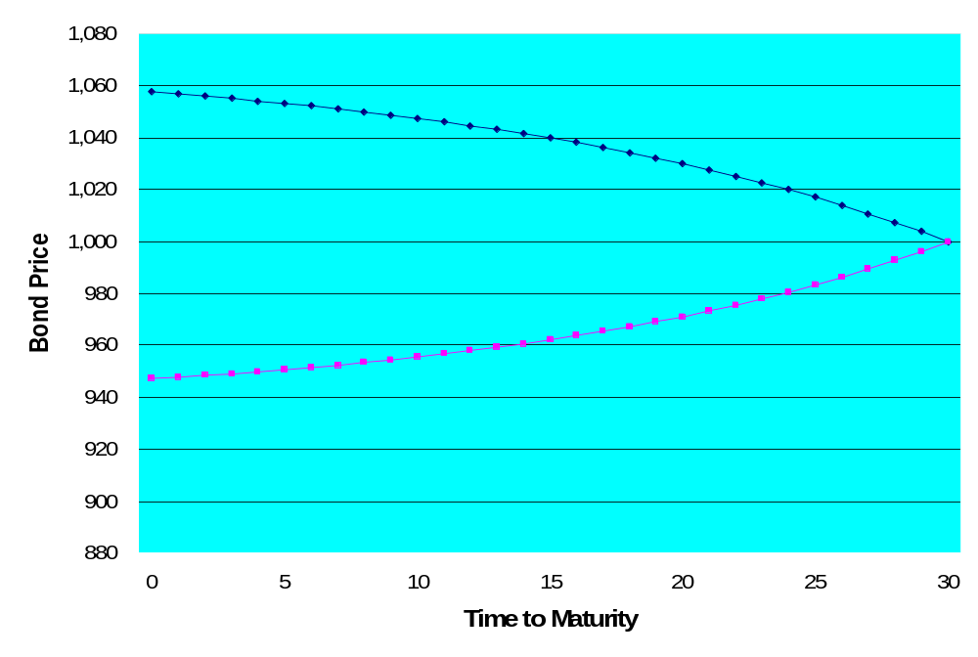
As Maturity Approaches
Price path for Premium Bond
Price path for Discount Bond
Today
Maturity
Notes:
Understanding Media: Extensions of Man, published in 1964.
The medium you use to send a particular message automatically predisposes audience members to make certain tacit assumptions about the message before they even read it.
Put another way, people unconsciously judge books by their covers.
How does this apply to business communications?
If you want to announce cutbacks in your company’s health benefits, don’t deliver the message with a glitzy, over-the-top, no-expenses-spared campaign.
Conversely, if you want to position your company as a leader in innovation, don’t advertise your message on sandwich boards dangling from the necks of ragamuffins traipsing around in front of gas stations.

Slide 34
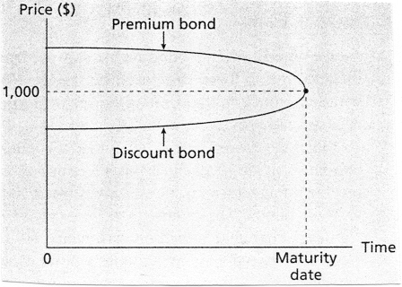
As Maturity Approaches
Notes:
Understanding Media: Extensions of Man, published in 1964.
The medium you use to send a particular message automatically predisposes audience members to make certain tacit assumptions about the message before they even read it.
Put another way, people unconsciously judge books by their covers.
How does this apply to business communications?
If you want to announce cutbacks in your company’s health benefits, don’t deliver the message with a glitzy, over-the-top, no-expenses-spared campaign.
Conversely, if you want to position your company as a leader in innovation, don’t advertise your message on sandwich boards dangling from the necks of ragamuffins traipsing around in front of gas stations.

Slide 35
Current Yield (CY)
Current Yield (CY) = annual coupon scaled by price
    Current Yield = $Annual Coupon Payment/Current Price
For a discount bond:
    CY < YTM (due to built-in capital gains in YTM)
For a premium bond:
    CY > YTM (due to built-in capital loss in YTM)
Notes:
Understanding Media: Extensions of Man, published in 1964.
The medium you use to send a particular message automatically predisposes audience members to make certain tacit assumptions about the message before they even read it.
Put another way, people unconsciously judge books by their covers.
How does this apply to business communications?
If you want to announce cutbacks in your company’s health benefits, don’t deliver the message with a glitzy, over-the-top, no-expenses-spared campaign.
Conversely, if you want to position your company as a leader in innovation, don’t advertise your message on sandwich boards dangling from the necks of ragamuffins traipsing around in front of gas stations.

Slide 36
Selling a Bond Early
Recall that YTM is yield promised to an investor who holds the bond until maturity
Question: What if you sell the bond early?
  Bond prices change when interest rates change
  If you sell prior to maturity, calculate return based on price at which you sell the bond
Example: Pay $1,100 for a bond, hold for 6 months and receive coupon payment of $50, then sell for $1,050
Notes:
Understanding Media: Extensions of Man, published in 1964.
The medium you use to send a particular message automatically predisposes audience members to make certain tacit assumptions about the message before they even read it.
Put another way, people unconsciously judge books by their covers.
How does this apply to business communications?
If you want to announce cutbacks in your company’s health benefits, don’t deliver the message with a glitzy, over-the-top, no-expenses-spared campaign.
Conversely, if you want to position your company as a leader in innovation, don’t advertise your message on sandwich boards dangling from the necks of ragamuffins traipsing around in front of gas stations.

Slide 37
Selling a Bond Early
Example: Pay $1,100 for a bond, hold for 6 months and receive coupon payment of $50, then sell for $1,050
Formula: i = [FV/PV]^{1/t}-1 = [(1,050+50)/1,100]^{1/1}-1 = 0%
Financial Calculator: 1n; $1,100PV; $50PMT; $1,050FV; i = 0%
Notes:
Understanding Media: Extensions of Man, published in 1964.
The medium you use to send a particular message automatically predisposes audience members to make certain tacit assumptions about the message before they even read it.
Put another way, people unconsciously judge books by their covers.
How does this apply to business communications?
If you want to announce cutbacks in your company’s health benefits, don’t deliver the message with a glitzy, over-the-top, no-expenses-spared campaign.
Conversely, if you want to position your company as a leader in innovation, don’t advertise your message on sandwich boards dangling from the necks of ragamuffins traipsing around in front of gas stations.

Slide 38
Risks Faced by Bond Investor
Is bond investing risky?
    Yes!
Three risk faced by bond investor:
  Interest rate risk (or price risk) – Risk associated with price fluctuations caused by interest rate changes
  Reinvestment rate risk – Risk associated with the rate at which coupons are reinvested
  Default risk (or credit risk) – Risk associated with issuer’s ability to make payments as specified
Notes:
Understanding Media: Extensions of Man, published in 1964.
The medium you use to send a particular message automatically predisposes audience members to make certain tacit assumptions about the message before they even read it.
Put another way, people unconsciously judge books by their covers.
How does this apply to business communications?
If you want to announce cutbacks in your company’s health benefits, don’t deliver the message with a glitzy, over-the-top, no-expenses-spared campaign.
Conversely, if you want to position your company as a leader in innovation, don’t advertise your message on sandwich boards dangling from the necks of ragamuffins traipsing around in front of gas stations.

Slide 39
Interest Rate Risk
Price moves inversely with interest rates
    Interest rates increase – Bond prices decrease
    Interest rates decrease – Bond prices increase
Longer-term bonds have greater interest rate risk
Lower-coupon bonds have greater interest rate risk
If a bond is held to maturity, interest rate risk is irrelevant
Notes:
Understanding Media: Extensions of Man, published in 1964.
The medium you use to send a particular message automatically predisposes audience members to make certain tacit assumptions about the message before they even read it.
Put another way, people unconsciously judge books by their covers.
How does this apply to business communications?
If you want to announce cutbacks in your company’s health benefits, don’t deliver the message with a glitzy, over-the-top, no-expenses-spared campaign.
Conversely, if you want to position your company as a leader in innovation, don’t advertise your message on sandwich boards dangling from the necks of ragamuffins traipsing around in front of gas stations.

Slide 40
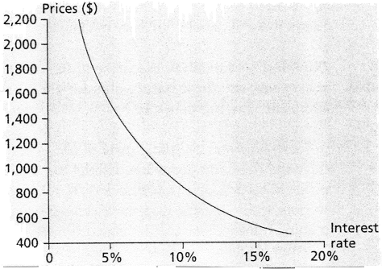
Interest Rate Risk
Negative slope illustrates inverse relationship between bond prices and interest rates
Notes:
Understanding Media: Extensions of Man, published in 1964.
The medium you use to send a particular message automatically predisposes audience members to make certain tacit assumptions about the message before they even read it.
Put another way, people unconsciously judge books by their covers.
How does this apply to business communications?
If you want to announce cutbacks in your company’s health benefits, don’t deliver the message with a glitzy, over-the-top, no-expenses-spared campaign.
Conversely, if you want to position your company as a leader in innovation, don’t advertise your message on sandwich boards dangling from the necks of ragamuffins traipsing around in front of gas stations.

Slide 41
Reinvestment Rate Risk
YTM calculation: Coupons are reinvested at the YTM
    Think back to the annuity formula…Same is true there
    What if you cannot reinvest at YTM…Then you cannot earn the YTM!
Example: Purchase 1-year bond with a 10% coupon for $1,050
    YTM =???
    $1,050 and the bond are equivalent in value…Each should give you the same FV at the end of year 1
    For this to be true, you must invest all coupons at YTM
Notes:
Understanding Media: Extensions of Man, published in 1964.
The medium you use to send a particular message automatically predisposes audience members to make certain tacit assumptions about the message before they even read it.
Put another way, people unconsciously judge books by their covers.
How does this apply to business communications?
If you want to announce cutbacks in your company’s health benefits, don’t deliver the message with a glitzy, over-the-top, no-expenses-spared campaign.
Conversely, if you want to position your company as a leader in innovation, don’t advertise your message on sandwich boards dangling from the necks of ragamuffins traipsing around in front of gas stations.

Slide 42
Reinvestment Rate Risk
Reinvestment risk is the risk related to the rate at which coupons are reinvested
Note: Interest rate risk and reinvestment risk work in opposite directions
    Long-term bonds are subject to greater interest rate risk (also called maturity risk) on principal than are short-term bonds
    Short-term bonds are subject to greater reinvestment rate risk on principal than are long-term bonds
    Both L-T and S-T bonds are subject to reinvestment risk on coupons!
Notes:
Understanding Media: Extensions of Man, published in 1964.
The medium you use to send a particular message automatically predisposes audience members to make certain tacit assumptions about the message before they even read it.
Put another way, people unconsciously judge books by their covers.
How does this apply to business communications?
If you want to announce cutbacks in your company’s health benefits, don’t deliver the message with a glitzy, over-the-top, no-expenses-spared campaign.
Conversely, if you want to position your company as a leader in innovation, don’t advertise your message on sandwich boards dangling from the necks of ragamuffins traipsing around in front of gas stations.

Slide 43
Default Risk
Default risk is the risk issuer won’t make payments as specified in the contract
    Default = not paying the full amount
    Default = not paying at the appropriate time
Bond rating agencies assess the default risk of borrowers
Default premium = higher interest rate to compensate the bondholder for the risk of default
Notes:
Understanding Media: Extensions of Man, published in 1964.
The medium you use to send a particular message automatically predisposes audience members to make certain tacit assumptions about the message before they even read it.
Put another way, people unconsciously judge books by their covers.
How does this apply to business communications?
If you want to announce cutbacks in your company’s health benefits, don’t deliver the message with a glitzy, over-the-top, no-expenses-spared campaign.
Conversely, if you want to position your company as a leader in innovation, don’t advertise your message on sandwich boards dangling from the necks of ragamuffins traipsing around in front of gas stations.

Slide 44
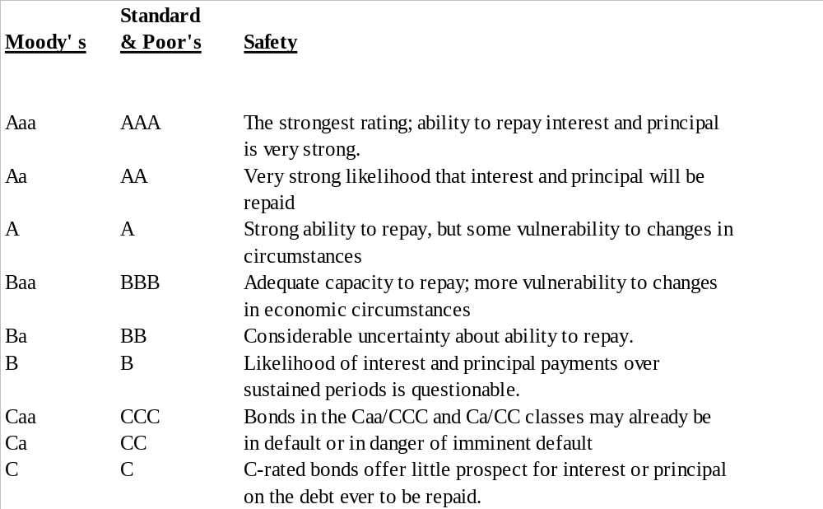
Bond Ratings
Notes:
Understanding Media: Extensions of Man, published in 1964.
The medium you use to send a particular message automatically predisposes audience members to make certain tacit assumptions about the message before they even read it.
Put another way, people unconsciously judge books by their covers.
How does this apply to business communications?
If you want to announce cutbacks in your company’s health benefits, don’t deliver the message with a glitzy, over-the-top, no-expenses-spared campaign.
Conversely, if you want to position your company as a leader in innovation, don’t advertise your message on sandwich boards dangling from the necks of ragamuffins traipsing around in front of gas stations.

Slide 45
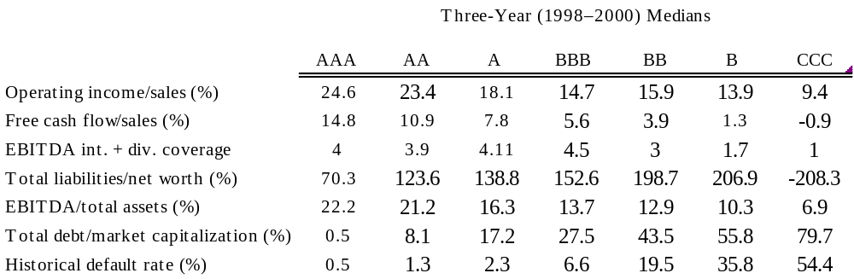
Financial Ratios and Default Risk
Note: EBITDA is earnings before interest, taxes, depreciation, and amortization.
Sources: Default rates from “Statement of Standard & Poor’s on Credit Rating Agencies to SEC,” Public Hearing, November 2002; all other data from Standard & Poor’s
Notes:
Understanding Media: Extensions of Man, published in 1964.
The medium you use to send a particular message automatically predisposes audience members to make certain tacit assumptions about the message before they even read it.
Put another way, people unconsciously judge books by their covers.
How does this apply to business communications?
If you want to announce cutbacks in your company’s health benefits, don’t deliver the message with a glitzy, over-the-top, no-expenses-spared campaign.
Conversely, if you want to position your company as a leader in innovation, don’t advertise your message on sandwich boards dangling from the necks of ragamuffins traipsing around in front of gas stations.

Slide 46
YTM and Expected Return
Promised YTM = Calculation based on what is specified in the contract
Expected Return (i.e., expected YTM) = Calculation based on expected payments
  If default becomes more likely, expected payments go down
  Example: 10% coupon bond with 5 years remaining has a price of $700…Promised maturity payment is $1,000, but market expects only $800…Recalculate yield using $800 as final cash flow rather than $1,000
Expected Return ≤ Promised YTM
Notes:
Understanding Media: Extensions of Man, published in 1964.
The medium you use to send a particular message automatically predisposes audience members to make certain tacit assumptions about the message before they even read it.
Put another way, people unconsciously judge books by their covers.
How does this apply to business communications?
If you want to announce cutbacks in your company’s health benefits, don’t deliver the message with a glitzy, over-the-top, no-expenses-spared campaign.
Conversely, if you want to position your company as a leader in innovation, don’t advertise your message on sandwich boards dangling from the necks of ragamuffins traipsing around in front of gas stations.

Slide 47
Special Cases
Zero-Coupon Bonds: Coupon rate of 0%
  Par repayment is only cash flow
  Sells at a discount
  All else equal, they have greater interest rate risk
Floating-Rate Bonds: Coupon payments change over the bond’s life
  Rate typically indexed to some market rate
  Reduce interest rate risk
Notes:
Understanding Media: Extensions of Man, published in 1964.
The medium you use to send a particular message automatically predisposes audience members to make certain tacit assumptions about the message before they even read it.
Put another way, people unconsciously judge books by their covers.
How does this apply to business communications?
If you want to announce cutbacks in your company’s health benefits, don’t deliver the message with a glitzy, over-the-top, no-expenses-spared campaign.
Conversely, if you want to position your company as a leader in innovation, don’t advertise your message on sandwich boards dangling from the necks of ragamuffins traipsing around in front of gas stations.

Slide 48
Bonds with Options Attached
Option gives one party the ability to change the terms of the contract
How does this affect the interest rate?
  Option benefits the borrower…Higher interest rate
  Option benefits the lender (investor)…Lower interest rate
Notes:
Understanding Media: Extensions of Man, published in 1964.
The medium you use to send a particular message automatically predisposes audience members to make certain tacit assumptions about the message before they even read it.
Put another way, people unconsciously judge books by their covers.
How does this apply to business communications?
If you want to announce cutbacks in your company’s health benefits, don’t deliver the message with a glitzy, over-the-top, no-expenses-spared campaign.
Conversely, if you want to position your company as a leader in innovation, don’t advertise your message on sandwich boards dangling from the necks of ragamuffins traipsing around in front of gas stations.

Slide 49
Convertible Bonds
Conversion option gives the bondholder the ability to convert the bond into a specified number of shares of the issuer’s stock
  Often issued by young firms
  If stock price increases, bondholder converts
  If stock price doesn’t increase, bondholder does nothing (i.e., continues to hold the bond)
Convertible bond will have a lower interest rate, all else equal
Notes:
Understanding Media: Extensions of Man, published in 1964.
The medium you use to send a particular message automatically predisposes audience members to make certain tacit assumptions about the message before they even read it.
Put another way, people unconsciously judge books by their covers.
How does this apply to business communications?
If you want to announce cutbacks in your company’s health benefits, don’t deliver the message with a glitzy, over-the-top, no-expenses-spared campaign.
Conversely, if you want to position your company as a leader in innovation, don’t advertise your message on sandwich boards dangling from the necks of ragamuffins traipsing around in front of gas stations.

Slide 50
Callable Bonds
Call option allows issuer to pay bond off early at a pre-specified price and time (call it in)
  Call price typically greater than par value
  Call period is typically later in the bond’s life
  If interest rates go down, issuer can call the bonds in and then re-issue new bonds at a lower rate
  Yield-to-Call (YTC) = yield calculation that assumes bond will be called in
  Call price serves as a ceiling for the market price of the bond
Callable bond will have a higher interest rate, all else equal
Notes:
Understanding Media: Extensions of Man, published in 1964.
The medium you use to send a particular message automatically predisposes audience members to make certain tacit assumptions about the message before they even read it.
Put another way, people unconsciously judge books by their covers.
How does this apply to business communications?
If you want to announce cutbacks in your company’s health benefits, don’t deliver the message with a glitzy, over-the-top, no-expenses-spared campaign.
Conversely, if you want to position your company as a leader in innovation, don’t advertise your message on sandwich boards dangling from the necks of ragamuffins traipsing around in front of gas stations.

Slide 51
Thank you
Thank You!
Charles B. (Chip) Ruscher, PhD
Department of Finance and Business Economics

